Slide 1
Modelling Word Recognition with a Hopfield Network
By:
Gunnar Calvert, Ivonne Rubio, Andrew Lau, Ankey Zhu, Cooper Wang, Adriana Maza
Pod:
Zhuchengceratops_Kabuki

Slide 2
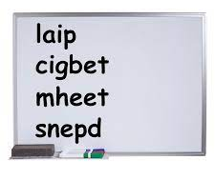
What is Pseudoword?
A string of letters that mimics a real word both orthographically and phonologically but is not a real, meaningful word that exists in the language.
“Aoccdrnig to a rscheearch at Cmabrigde Uinervtisy it deosn’t mttaer in waht oredr the ltteers in a wrod are. The olny iprmoatnt tihng is that the frist and lsat ltteer be at the rghit pclae. The rset can be a toatl mses and you can sitll raed it wouthit porbelm. Tihs is bcuseae the huamn mnid deos not raed ervey lteter by istlef but the wrod as a wlohe.” (Norris and Kinoshita, 2012)

Slide 3
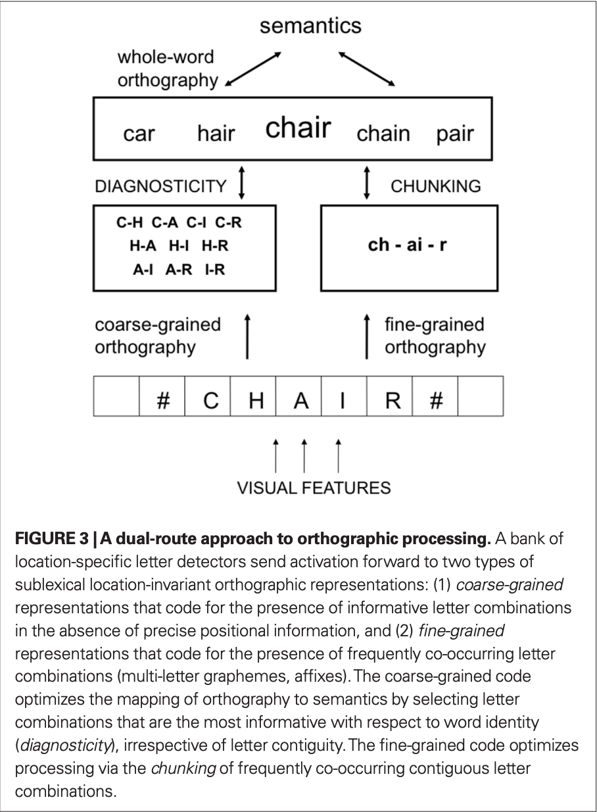
Possible Mechanism in Human Cognition
Dual-route approach to orthographic processing:
Coarse-grained route:
using subset of letters to recognises words quicker
Flexible letter position
Fine-grained route:
Sensitive to precise ordering of letters in words (e.g. beginning, ending)
Chunks frequently occurring letter combination
In other words, humans use coarse-grained route to recognise pseudowords with scrambled letter positioning
Notes:
Highlight the fact that letter positioning doesn’t matter as much in recognising words

Slide 4
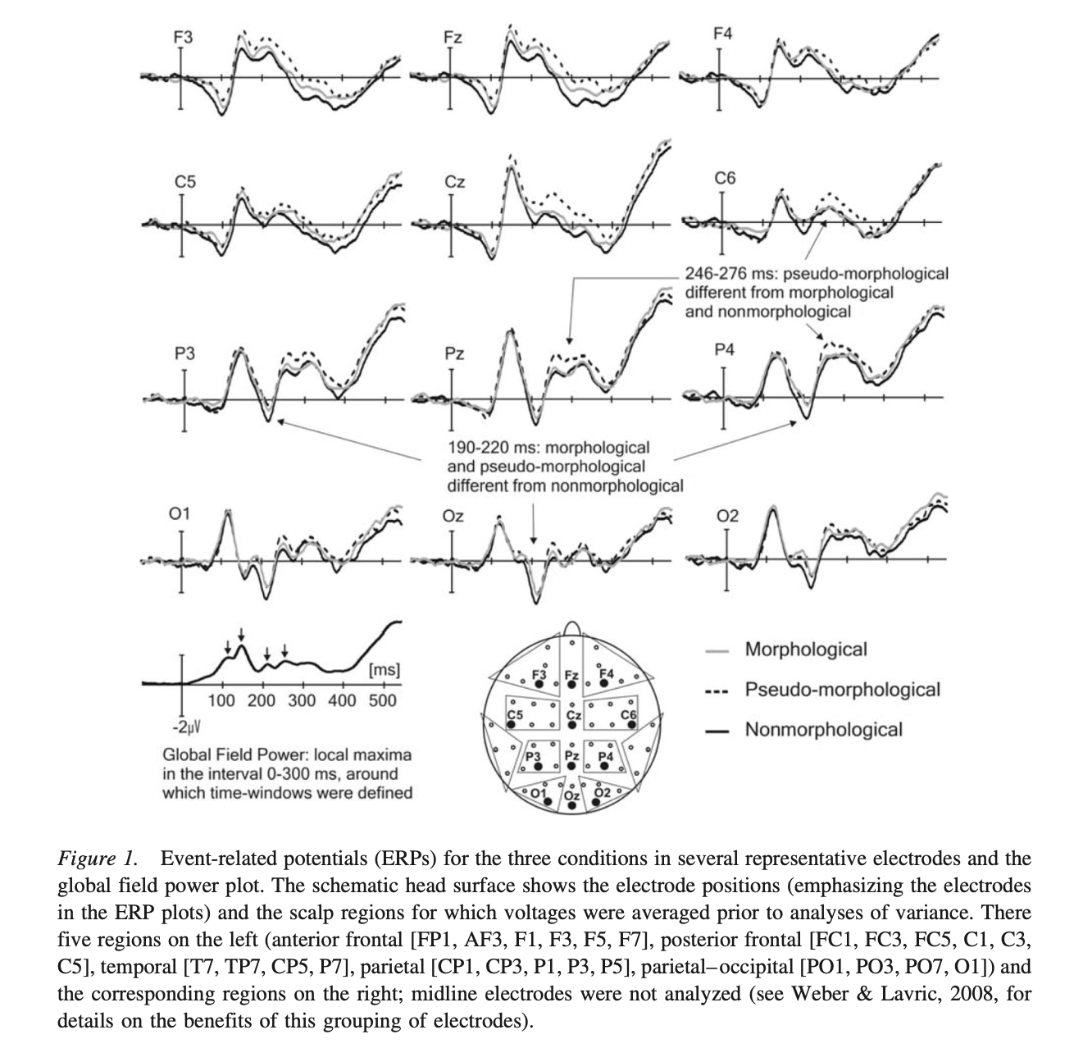
Possible Mechanism in Human Cognition
Hierarchical Process in the Brain:
Researchers asked if morphology (shape) and semantics (meaning) processing happen simultaneously?
Evidence from EEG experiment shows that humans process orthographic information before semantics, pointing towards a hierarchical process in word recognition
Notes:
Highlight the fact that word processing happens sequentially and hierarchically

Slide 5


Can we model it with a Hopfield Network?
A Hopfield network is a recurrent neural network with the number of neurons equal to the number of features.
We use Hebbian learning to train the network, i.e. the matrix average of the outer products of all memories:
Hopfield networks are commonly binary, in this case with , and a binarizing activation.
You can compute a quantity called energy of the Hopfield network by .
Energy decreases monotonically towards attractor point configurations of network parameters, with the local minimum representing stored memories.

Slide 6
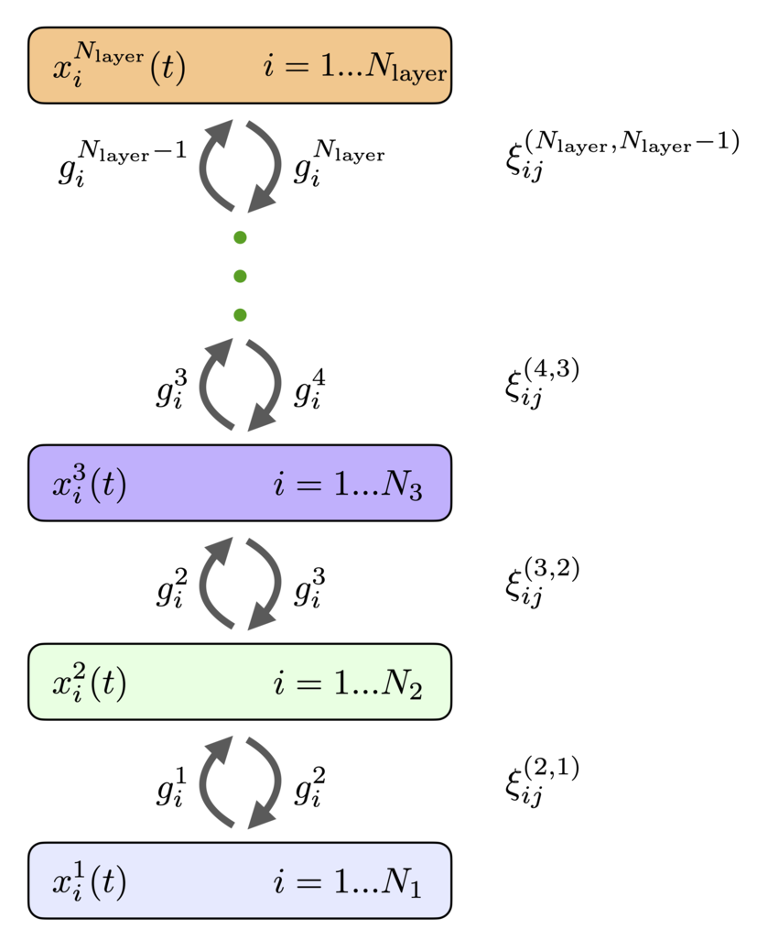
A Hierarchical Hopfield Network?
A multi-level Hopfield network would able to reuse low-level features in the representations of high-level features. Would a hierarchical hopfield network more effectively and efficiently recognize and remember dictionaries of words by recognizing and piecing together English words at the morpheme level?
This model makes use of some unbiological assumptions, such as the sharing of connection weights in both the feedforward and feedback directions.
This model also generalizes to convolutional input quite well, which could be useful.

Slide 7
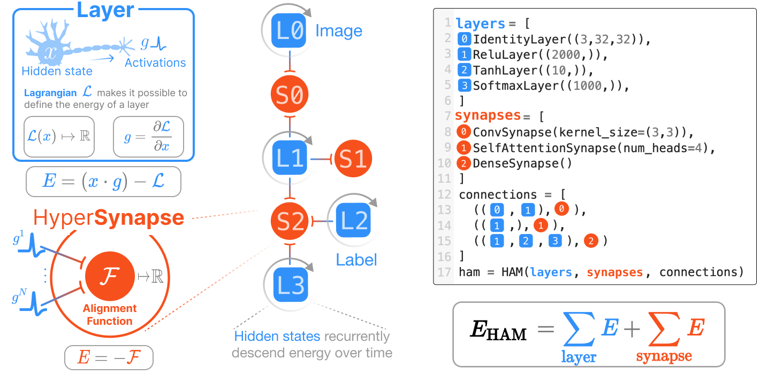
A Hierarchical Hopfield Network?
We were planning on using a package that made use of pytrees in JAX to build more complicated architectures, like hierarchical associative autoencoders, but a dependency called treex was deprecated, and so we moved on.

Slide 8
Experiment
The experiment takes in as an input:
Dictionaries that have different word lengths (5-10 word lengths)
An encoding function (One hot encoding and ASCII encoding)
A scramble function
With different levels of shuffling the words
Amount of trials
The network is trained and testing with each dictionary.
The experiment outputs the accuracy, distance, and energy for each trial and dictionary.

Slide 9
Results
Hierarchical Network Performance: deeper hierarchical networks sustained higher accuracy with increased dictionary length
Pseudowords Convergence: high accuracy in pseudowords converging to attractor point memories.

Slide 10
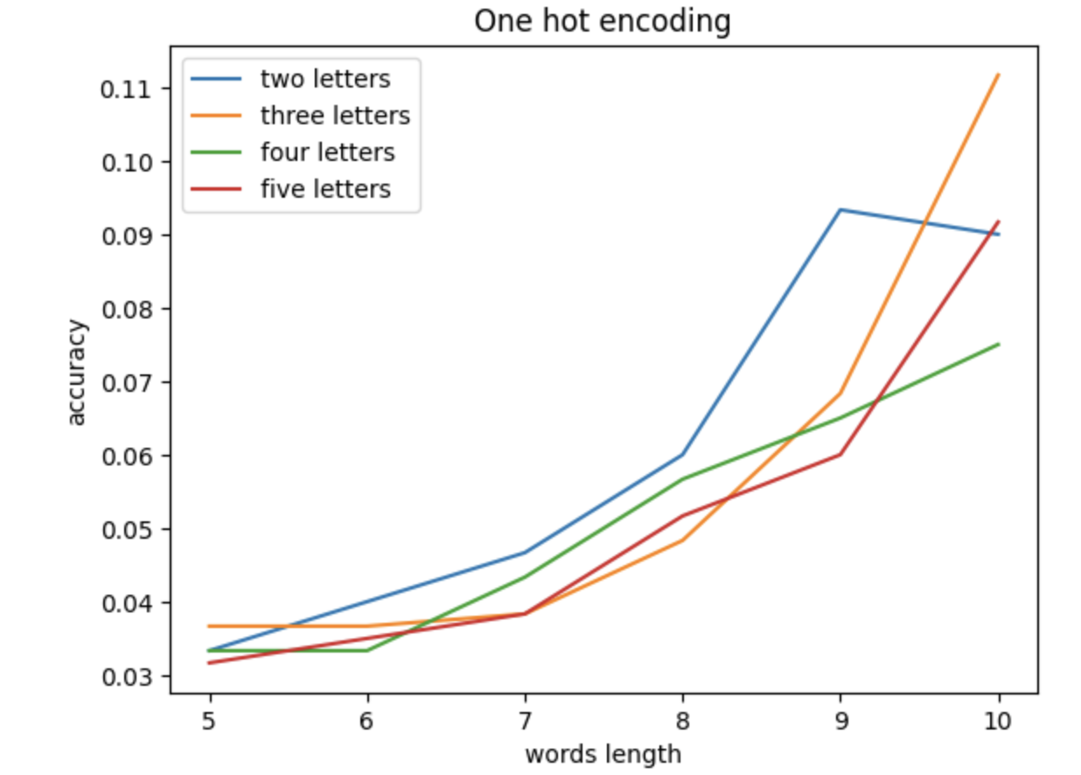
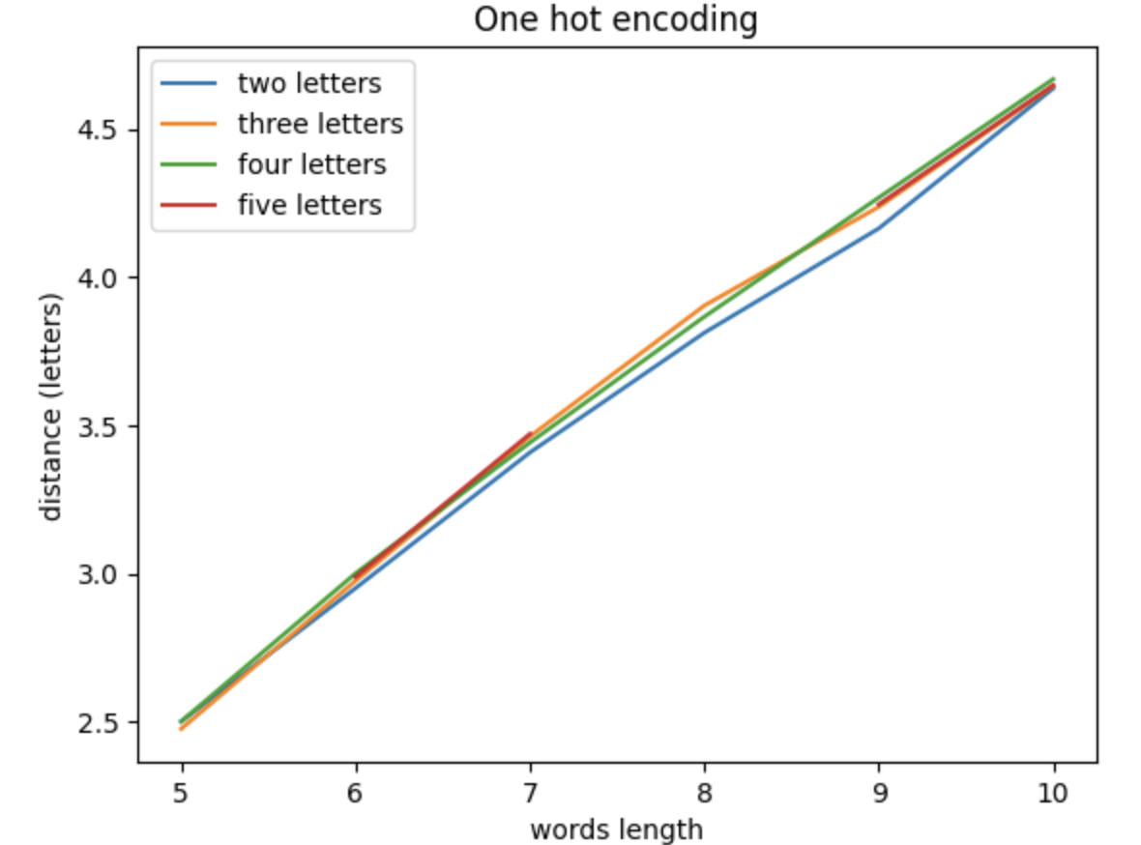
Results

Slide 11
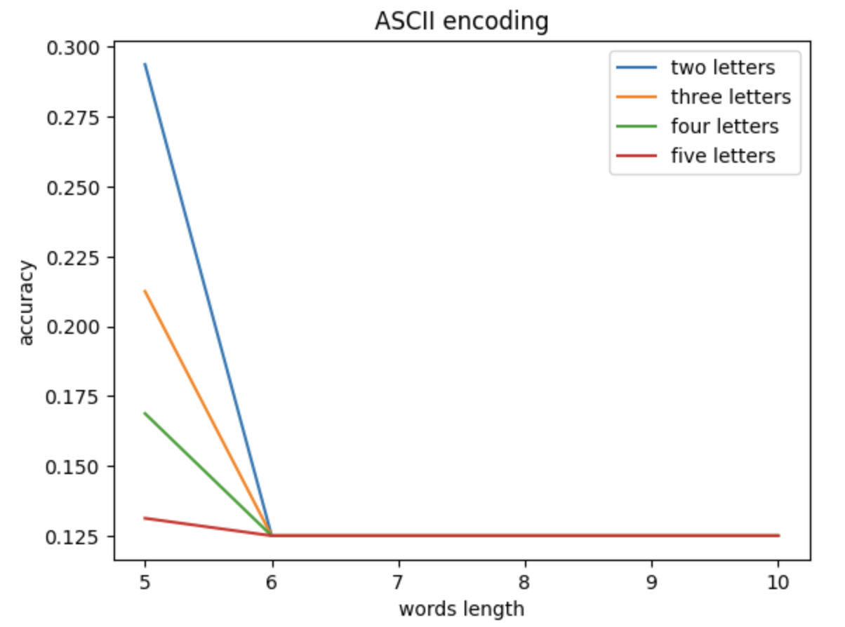
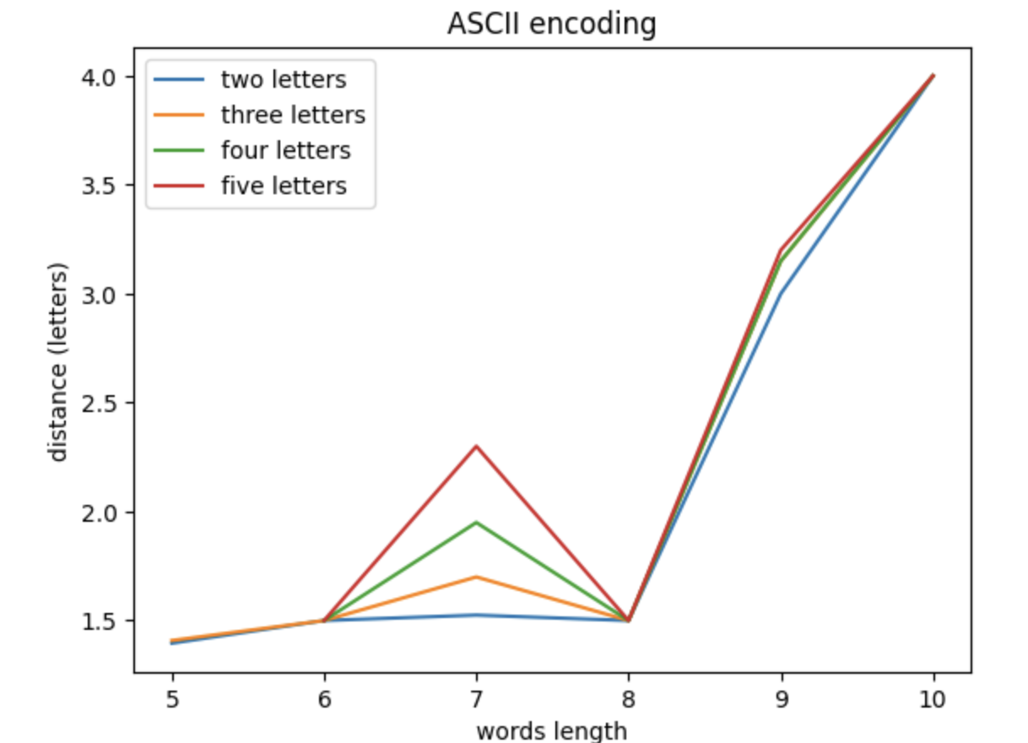
Results

Slide 12
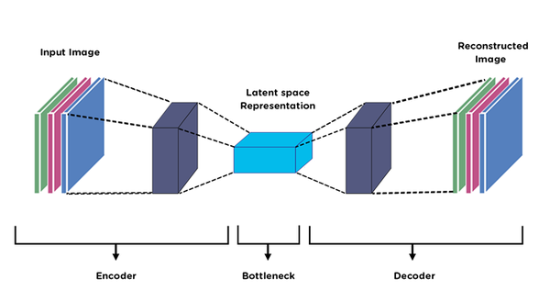
Discussion
1. Model Validation: We cannot confirm if the network accurately represents human cognitive processes. A means to investigate lower-dimensional latent space within the model is needed.
2. Future Direction - Autoencoding Architecture:
Recreating the generative human capabilities for word
synthesis from morphemes or other meaningful units.
3. Further Investigations: Correlations between vocabulary diversity, word frequency, and model accuracy.

